Slide 1
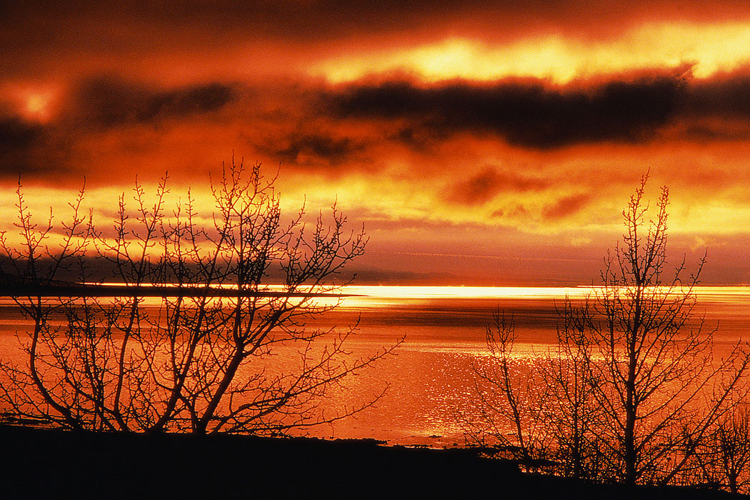
Summertime Sins
Part 2

Slide 2
Summertime Sins
FORSAKING
The Assembling of
Ourselves
Notes:
BEGIN SERMON 2
Sometimes in the summer (but not exclusively the summer) people tire themselves out with their worldly pursuits and now all of a sudden, the church doesn’t shine so bright in their lives.
The services of the church (which has an effect for eternity) is now found in a competition with the activities on earth (which only last a season). (Consider the confession of Bruce Riney.)
Sporting events, vacations, and even the “JOB” are good things, but should not be in competition with the kingdom of heaven. Summer can be a testing ground for your faith.
This is probably a sin that everyone has struggled with from one time or another in their life. But it is serious, nonetheless.

Slide 3
“not forsaking the assembling of ourselves together, as is the manner of some, but exhorting one another, and so much the more as you see the Day approaching” Heb. 10:25
FORSAKING – abandon, desert, to leave surviving
ASSEMBLING – gathering together (of ourselves)
  all religious gatherings of Christians in the congregation where we are members
THE MANNER OF SOME
  “habit” (New American Standard Greek Lexicon)
Notes:
[CLICK] Forsaking is to abandon . . .to forsake or abandon something necessarily implies that you have a duty/obligation to it.
You don’t forsake anything where you have no obligation.
[CLICK] ASSEMBLING: is the gathering of Christians together for religious purposes. You are not forsaking the assembling if you do not go to a potluck. But you are forsaking the assembling if you choose to neglect the services of the church.
[CLICK] Forsaking can develop into a habit. Regular worship can develop into a habit too. I speak of this in a positive way. You get to the point where you don't have to decide if you are going to services on Sunday and midweek. You don't have to consult your planer. You already know where you will be.

Slide 4
Can Make You Lost!
forsaking
To neglect the assembling of saints is to SIN!
God always held those who forsook the religious assemblies with contempt
  “But the man who is clean and is not on a journey, and ceases to keep the Passover, that same person shall be cut off from among his people, because he did not bring the offering of the LORD at its appointed time; that man shall bear his sin” (Num. 9:13)
legitimate reasons
not defiled by a dead man
shall die, be lost and condemned
not hung up too far away from Jerusalem
Notes:
CLICK THRU

Slide 5
Ways People Forsake
attending the “Mattress Springs Church of Christ”
  too tired to get up
seeks first money rather than the kingdom of God
  “gladly” takes extra hours at the job when it conflicts with worship
  “gladly” takes a job that will take him/her away from the worship services
    Never works with the employer to remedy the conflict

Slide 6
Ways People Forsake
seeks to recreate, even if it is away from God
  pretends he is a church by taking the elements of the Lord’s Supper with him on his pleasure trip
  doesn’t bother searching for a sound church to worship with when gone
  also “vacations away” from his duty to give
little or no concern about “Bible study”
  just getting to “worship service” is all that matters
  do as little as possible, concerned with minimum
  service
Sunday Sickness
Notes:
CLICK
[CLICK] NOTE1: L.S. is to be done when brethren come together as a church (1 Cor. 11:18; 20). Not alone, out and away from the church service.
[CLICK] NOTE2: we have provided those of you with computers links on our websites with sound churches. We even provide links where you cans search for the church in various areas. Use it!
[CLICK thru]

Slide 7
Why People Forsake
Forsaking is sin, but other sins lead to the action
  Not seeking first the kingdom of God (Matt. 6:33)
  Loving anything more than God will lead away from congregational gatherings (Mk. 12:30)
    We create idols when we place anything before God

Slide 8
Deuteronomy 5:8-10
8 ‘You shall not make for yourself a carved image—any likeness of anything that is in heaven above, or that is in the earth beneath, or that is in the water under the earth;
9 you shall not bow down to them nor serve them. For I, the LORD your God, am a jealous God, visiting the iniquity of the fathers upon the children to the third and fourth generations of those who hate Me,
10 but showing mercy to thousands, to those who love Me and keep My commandments.
Notes:
Keeping the commandments of God displays love to Him. But creating idols and serving them is a display of our hate toward God. It is very cut and dry with Him. We either love Him or hate Him. Our actions display the emotion we have.

Slide 9
A Remedy Against Forsaking?
Develop a love for God that is above and beyond anything else in this life (Mk. 12:30)
  Contemplating on what God’s love has done for you (1 Jn. 4:9, 19; Eph. 1:15-18)
  Considering the power of the loving Creator (Ps. 33:9; Eph. 1:19-21)
  Committing your soul into His care (1 Pet. 4:19)
  Anticipating the judgment to come (2 Pet. 3:11, 12, 14)

Slide 10
A Remedy Against Forsaking?
Developing a love for the church which Jesus exhibited (Acts 20:28; Eph. 1:22, 23; 5:25, 28, 29)
Recognizing that Satan wants you to fail
  Recognize his tactics (2 Cor. 2:11; 1 Pet. 5:8)
  Recognize his persistence (Neh. 6:1-4)
  Recognize his distractions (Neh. 6:5-9)

Slide 11
Have You Considered The Number of Sins Associated with Forsaking the Assembling of Ourselves Together?

Slide 12
Consider Hebrews 10:22-39
BRETHREN WHO FORSAKE. . .
do not draw near to God (v. 22)
do no have hearts full of faith (v. 22)
do not hold fast the confession of faith (v. 23)
do not have consideration for brethren (v. 24)
  do not exhort brethren

Slide 13
Consider Hebrews 10:22-39
BRETHREN WHO FORSAKE. . .
do not consider the “day” that is approaching (v. 25, cf. 27, 29, 30, 37)
  The fact of a future judgment day should behoove us all to be at every service!
sin willfully (v. 26)
forfeit the sacrifice for sins (v. 26)
await a judgment that is worse than that under Moses (v. 27-29)
trample under feet holy blood (v. 29)
Notes:
[CLICK THRU]

Slide 14
Consider Hebrews 10:22-39
BRETHREN WHO FORSAKE. . .
are neglectful of the covenant (v. 29)
insult the Spirit (v. 29)
have forgotten their former state (vv. 32, 33)
are not compassionate for brethren (v. 34)
have forgotten about heaven (v. 34)
cast away their confidence (v. 35)
have no endurance (v. 36)
give little thought of the second coming (v. 37)
are not living by faith but drawing back (v. 38)
do not have to continue to do so (v. 39)
Notes:
When you forsake the assemblings of saints, you not only trample the holy blood that ratified the covenant, but you also insult the Spirit who revealed the covenant! That means you stand before God in judgment without Jesus and the Holy Spirit. I don't envy that place!!!

Slide 15
Forsaking the Assembling of Ourselves
Toge
ther
Forsakes His Appointment To Commune With The Lord
  1 Cor. 11:23-34
Shows That He Prefers Someone Or Something Above The Lord
  Matt. 18:20; Lk. 14:15-24; 9:57-62; 14:26
The Person That Willfully Forsakes…
Notes:
charts 20-22 by Steve Monts
[CLICK]
[CLICK] The Lord’s presence is certainly in the church’s assembly. Choosing to willfully not come is choosing something above the Lord (read Lk. 14:15-24).

Slide 16
Forsaking the Assembling of Ourselves
Toge
ther
Denies His Allegiance To Christ That He Confessed At His Baptism
  Rom. 10:9-10; 2 Tim. 2:4; Heb. 12:2
Is Not Seeking First The Kingdom Of God And His Righteousness
  Matt. 6:33
The Person That Willfully Forsakes…
Notes:
CLICK THRU

Slide 17
Forsaking the Assembling of Ourselves
Toge
ther
The Person That Willfully Forsakes…
Offends The Church Of God
  1 Cor. 10:32
Hinders The Efforts Of The Church To Preach The Gospel
  1 Cor. 9:12
Neglects The Worship God Is Seeking
  Jn. 4:23-24
Notes:
[CLICK] “Give no offense, either to the Jews or to the Greeks or to the church of God” (1 Cor. 10:32)
[CLICK] “If others are partakers of this right over you, are we not even more? Nevertheless we have not used this right, but endure all things lest we hinder the gospel of Christ” (1 Cor. 9:12). The gospel can be hindered. Now, are you helping or hindering it when you are not here? What does it tell your neighbors, friends, children?
[CLICK]

Slide 18
What You Miss When You Are Willfully Gone!
singing
praying
learning
honoring God
approval from God
“Examine yourselves as to whether you are in the faith. Test yourselves. Do you not know yourselves, that Jesus Christ is in you? ––unless indeed you are disqualified”
(2 Cor. 13:5)
Notes:
Presenting lessons like this is for the benefit of the hearers. Worship is serious and we need to be serious about it. How we react to lessons like this shows what effect the word of God is having upon us. We need to examine ourselves. I am never beyond examination and neither should you be.

Slide 19
The PAST Doesn’t Have to Equal the FUTURE!
Even Saul said, "Indeed I have played the fool and erred exceedingly" (1 Sam. 26:21)
Notes:
I am not presenting this lesson to beat up on any one person. I simply want us to challenge ourselves to maturity. I want us to be honest and serious about who we are and to refuse the temptation to “play the fool.”
Even Saul said, "Indeed I have played the fool and erred exceedingly" (1 Sam. 26:21)
I want us to be more tomorrow than we are today. Our every action and inaction, decision or indecision has an effect on that growth! Think about it!
I want us to give grave consideration to the course we are chartering. Is it healthy for us? Is it good for our children? If you don’t have children but plan on having them, don’t you think it is important to get your ducks in a row now?
Why play the fool and wake up one day and see your children lost because they learned from your example to not esteem the services of the church???
They will learn from you and they will likely take your failure to newer depths.

